Slide 1


SAPUI5: Debugging XML Views
Version 1.0, July 2015
Author Ross Hightower
Product SAPUI5
Level Beginner
September 20, 2016
Focus
Debugging in SAPUI5
Public

Slide 2
Debugging XML Views
Because XML is not a procedural language, debugging problems require different techniques than debugging a language like JavaScript
There are three common classes of errors:
Incorrect declaration of the controller file
Missing SAPUI5 libraries
XML syntax errors
The first two types of errors are easy to spot based on the error messages generated in the developer tools console
More obscure syntax errors in a large XML files can be difficult but there are some techniques that make it easier

Slide 3
Errors Loading Files

Slide 4
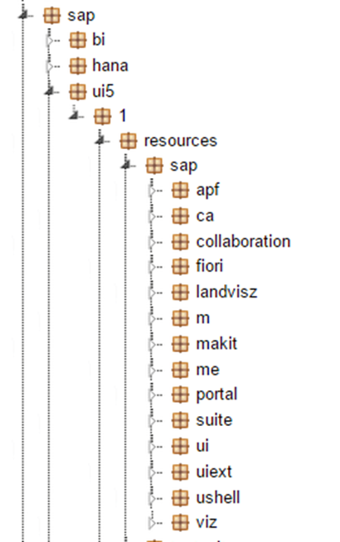
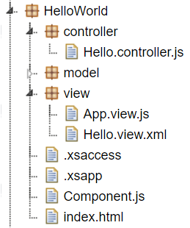
Application Structure
SAPUI5 loads the files required to run the application but you have to help it find them. The files it needs fall into two categories
SAPUI5 libraries
Your project files

Slide 5
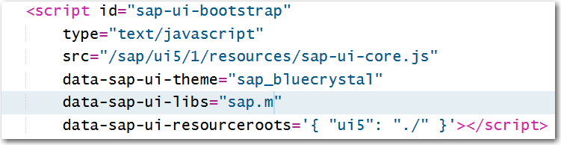
Bootstrapping SAPUI5 in the index.html file
The code below loads the sap-ui-core library which contains the core SAPUI5 libraries as well as jQuery. It then loads the sap.m namespace which contains common controls such as buttons and labels.
The last line defines the namespace for the application. Normally, SAPUI5 will look for application files relative to the location of the sap-ui-core.js file so we must define a namespace with which we can refer to application files that is relative to the root folder of the application.
Identifies the location of the SAPUI5 libraries
Identifies the root of the project directory structure

Slide 6
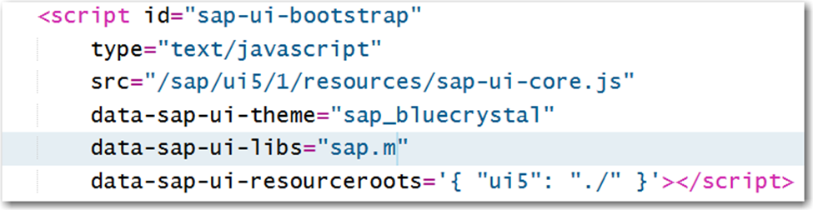
Application Structure

Slide 7
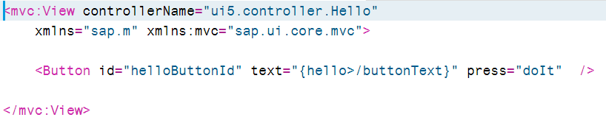
Anatomy of a XML View
Controller is named Hello and is located in the
controller directory immediately below to project root
The view is contained within <mvc:View> and </mvc:View> tags. In the opening tag the controller associated with the view is defined.
Note the use of the ui5 namespace that was created in the index.html file.
Any namespaces required for the view are also identified. These are loaded from the SAPUI5 library directories.

Slide 8
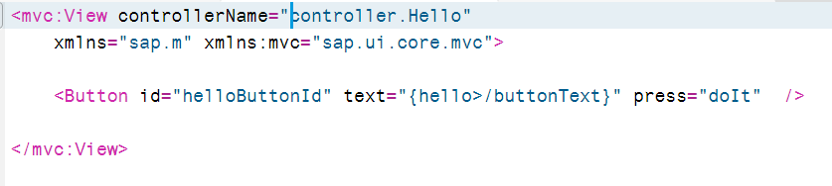
Incorrect Declaration of Controller File
The error below appears in the Console. Note SAPUI5 is attempting the load the Hello.controller.js file from the SAPUI5 directories instead of the project directories:
UIComponent.js:6 Uncaught Error: failed to load 'controller/Hello.controller.js' from /sap/ui5/1/resources/controller/Hello.controller.js: 404 - Not Found

Slide 9
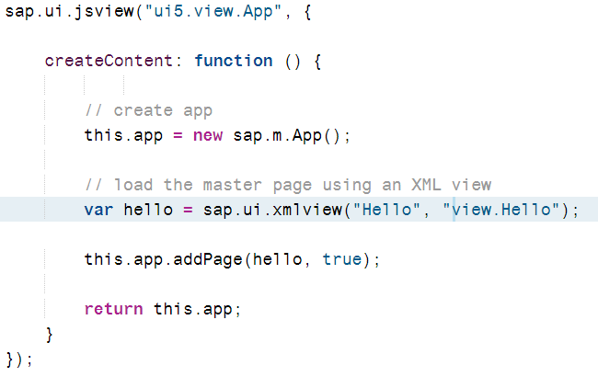
Error Loading XML File
You can have the same error when loading an XML view as well. In this case reference to the Hello.view.xml file in the App.view.js file is the problem.
UIComponent.js:6 Uncaught Error: resource view/Hello.view.xml could not be loaded from /sap/ui5/1/resources/view/Hello.view.xml. Check for 'file not found' or parse errors.

Slide 10
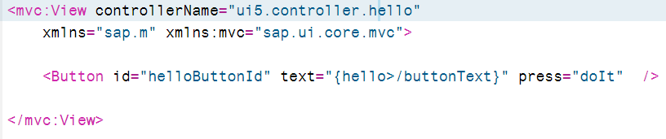
Wrong Name for Controller File
The controller file location is correct but the name is not (remember SAPUI5 is case sensitive). Note that SAPUI5 is looking for the file in the right location but you are still getting a 404 – Not Found error.
UIComponent.js:6 Uncaught Error: failed to load 'ui5/controller/hello.controller.js' from ./controller/hello.controller.js: 404 - Not Found

Slide 11
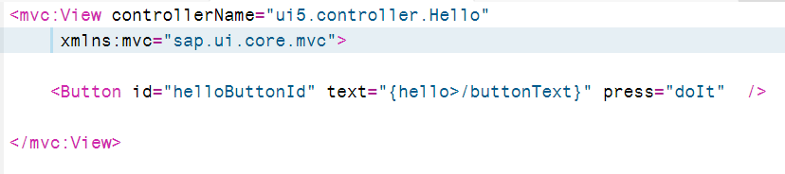
Missing SAPUI5 Library
Missing sap.m library
If the error references a specific control and is a 404 error then the most likely cause is that the required SAPUI5 library hasn’t been loaded or the control requires a prefix (i.e. <mvc:View>)
UIComponent.js:6 Uncaught Error: failed to load 'null/Button.js' from /sap/ui5/1/resources/null/Button.js: 404 - Not Found

Slide 12
XML Syntax Errors

Slide 13
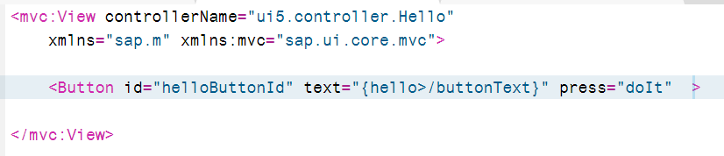
XML Errors
XML syntax errors can be difficult to find but error will look like this.
UIComponent.js:6 Uncaught Error: resource ui5/view/Hello.view.xml could not be loaded from ./view/Hello.view.xml. Check for 'file not found' or parse errors.

Slide 14
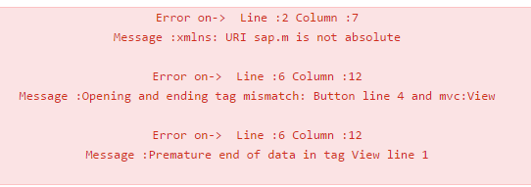
XML Validator
Small errors in complex XML can be difficult to find and traditional debugging techniques are not available
An XML validator can help to find XML errors
http://codebeautify.org/xmlvalidate
Always there but isn’t a problem
Identifies the error

Slide 15
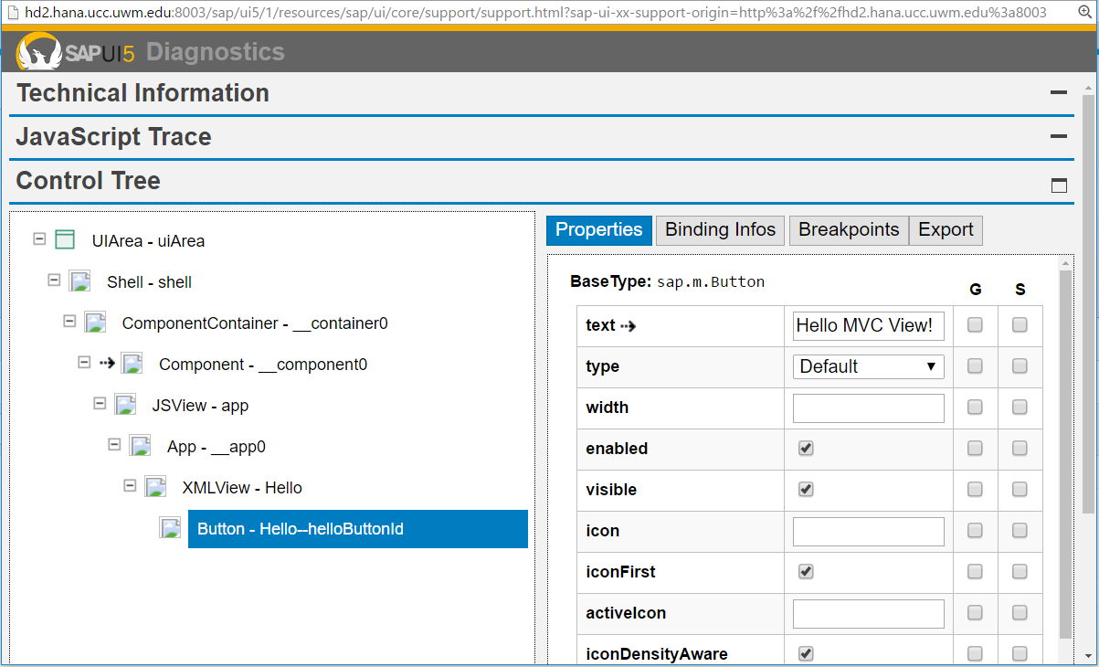
SAPUI5 Diagnostics
Hit ctrl-alt-shift-s opens a SAPUI5 Diagnostics tool which can be helpful once you’ve gained some experience.

Slide 16
Thank you
Contact information:
Ross Hightower
hightowe@uwm.edu

